Slide 1
JSP(Java Server Pages)
It is a technology for developing web pages that support dynamic content which helps developers insert java code in HTML pages by making use of special JSP tags, most of which start with <% and end with %>.
A JavaServer Pages component is a type of Java servlet that is designed to fulfill the role of a user interface for a Java web application.
Web developers write JSPs as text files that combine HTML or XHTML code, XML elements, and embedded JSP actions and commands.
Java Servlets are programs that run on a Web or Application server and act as a middle layer between a request coming from a Web browser or other HTTP client and databases or applications on the HTTP server.

Slide 2
Contd…
JSP technology is used to create web application just like Servlet technology.
It can be thought of as an extension to servlet because it provides more functionality than servlet such as expression language, jstl etc
JavaServer Pages (JSP) technology provides a simplified, fast way to create dynamic web content.
JSP technology enables rapid development of web-based applications that are server- and platform-independent

Slide 3
Servlets
We can collect input from users through web page forms, present records from a database or another source, and create web pages dynamically.
Java Servlets often serve the same purpose as programs implemented using the Common Gateway Interface (CGI). But Servlets offer several advantages in comparison with the CGI
Performance is significantly better.
Servlets execute within the address space of a Web server. It is not necessary to create a separate process to handle each client request.
Servlets are platform-independent because they are written in Java.
Java security manager on the server enforces a set of restrictions to protect the resources on a server machine. So servlets are trusted.
The full functionality of the Java class libraries is available to a servlet. It can communicate with applets, databases

Slide 4
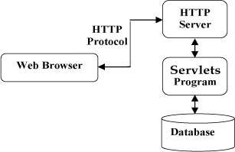
Servlets Architecture

Slide 5
Servlets - Life Cycle
A servlet life cycle can be defined as the entire process from its creation till the destruction.
init()
service()
destroy()
The init() method :
The init method is designed to be called only once. It is called when the servlet is first created, and not called again for each user request. So, it is used for one-time initializations, just as with the init method of applets.

Slide 6
Contd…
The servlet is normally created when a user first invokes a URL corresponding to the servlet
The init() method simply creates or loads some data that will be used throughout the life of the servlet.
The init method definition looks like this:
public void init() throws ServletException
{ // Initialization code...}

Slide 7
The service() method
The service() method is the main method to perform the actual task.
The servlet container (i.e. web server) calls the service() method to handle requests coming from the client( browsers) and to write the formatted response back to the client.
Each time the server receives a request for a servlet, the server produce a new thread and calls service.
The service() method checks the HTTP request type (GET, POST, PUT, DELETE, etc.) and calls doGet, doPost, doPut, doDelete, etc.

Slide 8
Contd…
Here is the signature of this method:
public void service(ServletRequest request,
ServletResponse response)
throws ServletException, IOException{
}

Slide 9
The destroy() method
The destroy() method is called only once at the end of the life cycle of a servlet.
This method gives your servlet a chance to close database connections, halt background threads, write cookie lists or hit counts to disk, and perform other such cleanup activities.
After the destroy() method is called, the servlet object is marked for garbage collection. The destroy method definition looks like this:s
public void destroy()
{ // Finalization code... }

Slide 10
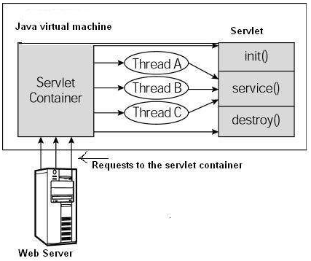
Architecture Diagram

Slide 11
The servlet can be created by three ways:
By implementing Servlet interface,
By inheriting GenericServlet class, (or)
By inheriting HttpServlet class
The mostly used approach is by extending HttpServlet because it provides http request specific method such as doGet(), doPost(), doHead() etc.
Example

Slide 12
Servlet Deployment
For using apache tomcat server. The deployment steps are as follows:
Create a directory structure
Create and Compile the Servlet. Then, copy the servlet’s class file to the proper directory, and add the servlet’s name and mapping to the proper web.xml file
Create a deployment descriptor
Start the server and deploy the project
Access the servlet

Slide 13
Web.xml
<web-app>
<servlet>
<servlet-name>HelloWorld</servlet-name>
<servlet-class>HelloWorld</servlet-class>
</servlet>
<servlet-mapping>
<servlet-name>HelloWorld</servlet-name>
<url-pattern>/HelloWorld</url-pattern>
</servlet-mapping></web-app>

Slide 14
Difference Between JSP and Servlet:
Servlet is html in java whereas JSP is java in html.
Servlets run faster compared to JSP and JSP can be compiled into Java Servlets
It’s easier to code in JSP than in Java Servlets
JSP is a webpage scripting language that can generate dynamic content while Servlets are Java programs that are already compiled which also creates dynamic web content
JSP are generally preferred when there is not much processing of data required. But servlets are best for use when there is more processing and manipulation involved.
In JSP, we can build custom tags which can directly call Java beans. There is no such facility in servlets.
We can achieve functionality of JSP at client side by running JavaScript at client side. There are no such methods for servlets.
A servlet is like any other Java class. we put HTML into print statements like you use System.out or how JavaScript uses document.write.

Slide 15
HTTP requests Handling
To handle HTTP requests in a servlet, extend the HttpServlet class and override the servlet methods that handle the HTTP requests which servlet supports.
Servlets can be used for handling both the GET Requests and the POST Requests. The methods that handle these requests are
doGet()
doPost()
doPut()
doDelete()
doOptions()
doTrace()

Slide 16
Handling HTTP GET Requests
The Servlet is invoked when a form on a web page is submitted.
The URL identifies a servlet to process the HTTP GET request.
The doGet() method is overridden to process any HTTP GET requests that sent to servlet.
It may use getParameter() method of HttpServletRequest to obtain information that was made by the user. A response is then formulated.

Slide 17
Handling HTTP POST Requests
The doPost() method is overridden to process any HTTP POST requests that are sent to this servlet.
It uses the getParameter() method of HttpServletRequest to obtain the information that was made by the user. A response is then formulated

Slide 18
Session Management
Session simply means a particular interval of time.
Session Tracking is a way to maintain state (data) of an user.
It requires to recognize the user. It is used to recognize the particular user.
Http protocol is a stateless so we need to maintain state using session tracking techniques.
Each time user requests to the server, server treats the request as the new request. So we need to maintain the state of an user to recognize to particular user.
HTTP is stateless that means each request is considered as the new request.

Slide 19
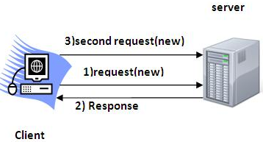
http request and response flow

Slide 20
Session Tracking Techniques
There are four techniques used in Session tracking:
Cookies
Hidden Form Field
URL Rewriting
HttpSession

Slide 21
Cookies in Servlet
A cookie is a small piece of information that is persisted between the multiple client requests.
A cookie has a name, a single value, and optional attributes such as a comment, path and domain qualifiers, a maximum age, and a version number.
Example
Cookie ck=new Cookie("user","binod");//creating cookie object
response.addCookie(ck);//adding cookie in the response
Advantage of Cookies
Simplest technique of maintaining the state. Cookies are maintained at client side.
Disadvantage of Cookies
It will not work if cookie is disabled from the browser.
Only textual information can be set in Cookie object

Slide 22
2) Hidden Form Field
A hidden (invisible) textfield is used for maintaining the state of an user.
We store the information in the hidden field and get it from another servlet. This approach is better if we have to submit form in all the pages and we don't want to depend on the browser.
Exampl: <input type="hidden" name="uname" value="Vimal Jaiswal">
Advantage of Hidden Form Field
It will always work whether cookie is disabled or not.
Disadvantage of Hidden Form Field:
It is maintained at server side.Extra form submission is required on each pages.
Only textual information can be used.

Slide 23
3) URL rewriting
we append a token or identifier to the URL of the next Servlet or the next resource. We can send parameter name/value pairs using the following format:
url?name1=value1&name2=value2&??
Parameters are separated using the ampersand(&). When the user clicks the hyperlink, the parameter name/value pairs will be passed to the server. From a Servlet, we can use getParameter() method to obtain a parameter value.
Advantage of URL Rewriting
It will always work whether cookie is disabled or not (browser independent).
Extra form submission is not required on each pages.
Disadvantage of URL Rewriting
It will work only with links. It can send only textual information.

Slide 24
4) HttpSession Interface
The container creates a session id for each user. The container uses this id to identify the particular user. An object of HttpSession can be used to perform two tasks:
bind objects
view and manipulate information about a session, such as the session identifier, creation time, and last accessed time.
Example
String n=request.getParameter("userName");
out.print("Welcome "+n);
HttpSession session=request.getSession();
session.setAttribute("uname",n);

Slide 25
JSP Life Cycle
A JSP life cycle can be defined as the entire process from its creation till the destruction which is similar to a servlet life cycle with an additional step which is required to compile a JSP into servlet.
The following are the paths followed by a JSP
Compilation
Initialization
Execution
Cleanup

Slide 26
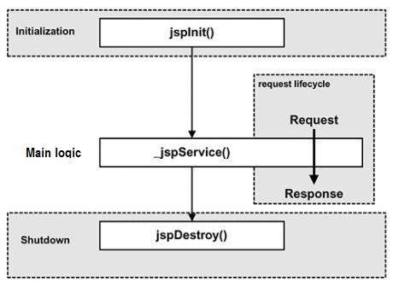

Slide 27
Java Server Pages Standard Tag Library (JSTL)
The JavaServer Pages Standard Tag Library (JSTL) is a collection of useful JSP tags which encapsulates core functionality common to many JSP applications.
JSTL has support for common, structural tasks such as iteration and conditionals, tags for manipulating XML documents, internationalization tags, and SQL tags.
It also provides a framework for integrating existing custom tags with JSTL tags.

Slide 28
The JSTL tags can be classified, according to their functions:
Core Tags
Formatting tags
SQL tags
XML tags
JSTL Functions

Slide 29
Core tags:
The JSTL core tag provide variable support, URL management, flow control etc. syntax:
<%@ taglib prefix="c" uri="http://java.sun.com/jsp/jstl/core" %>
Tag | Description
<c:out > | Like <%= ... >, <c:out value="${'Welcome to javaTpoint'}"/>
<c:set > | Sets the result of an expression evaluation in a 'scope’ <c:set var="Amount" value="9850.14115" />
<c:forEach > | The basic iteration tag, accepting many different collection types and supporting subsetting and other functionality .
<c:redirect > | Redirects to a new URL. <c:redirect url="http://facebook.com"/>

Slide 30
Formatting Tags:
The JSTL formatting tags are used to format and display text, the date, the time, and numbers for internationalized Web sites. Syntax:
<%@ taglib prefix="fmt" uri="http://java.sun.com/jsp/jstl/fmt" %>
Tag | Description
<fmt:formatNumber> | To render numerical value with specific precision or format. <fmt:formatNumber value="${Amount}" type="currency" />
<fmt:formatDate> | Formats a date and/or time using the supplied styles and pattern. <c:set var="Date" value="<%=new java.util.Date()%>" /> <fmt:formatDate type="date" value="${Date}" />
<fmt:message> | To display an internationalized message.

Slide 31
SQL Tags:
The JSTL SQL tag library provides tags for interacting with relational databases (RDBMSs) such as Oracle, mySQL, or Microsoft SQL Server.
<%@ taglib prefix="sql" uri="http://java.sun.com/jsp/jstl/sql" %>
Teg | Description
<sql:setDataSource> | Creates a simple DataSource suitable only for prototyping
<sql:query> | Executes the SQL query defined in its body or through the sql attribute.
<sql:update> | Executes the SQL update defined in its body or through the sql attribute.
<sql:param> | Sets a parameter in an SQL statement to the specified value.

Slide 32
<sql:setDataSource var="db" driver="com.mysql.jdbc.Driver"
url="jdbc:mysql://localhost/test"
user="root" password="1234"/>
<sql:query dataSource="${db}" var="rs">
SELECT * from Students;
</sql:query>
<sql:update dataSource="${db}" var="count">
DELETE FROM Students WHERE Id = ?
<sql:param value="${StudentId}" />
</sql:update>

Slide 33
XML tags:
The JSTL XML tags provide a JSP-centric way of creating and manipulating XML documents.
The JSTL XML tag library has custom tags for interacting with XML data. This includes parsing XML, transforming XML data, and flow control based on XPath expressions.
<%@ taglib prefix="x" uri="http://java.sun.com/jsp/jstl/xml" %>
Tag | Description
<x:out> | Like <%= ... >, but for XPath expressions.
<x:parse> | Use to parse XML data specified either via an attribute or in the tag body.
<x:set > | Sets a variable to the value of an XPath expression.
<x:forEach> | To loop over nodes in an XML document.

Slide 34
JSTL Functions:
JSTL includes a number of standard functions, most of which are common string manipulation functions. syntax
<%@ taglib prefix="fn" uri="http://java.sun.com/jsp/jstl/functions" %>
Function | Description
fn:contains() | Tests if an input string contains the specified substring.
fn:endsWith() | Tests if an input string ends with the specified suffix.
fn:indexOf() | Returns the index withing a string of the first occurrence of a specified substring.
fn:replace() | Returns a string resulting from replacing in an input string all occurrences with a given string.

Slide 35
<c:set var="String" value="Welcome to javatpoint"/>
<c:if test="${fn:contains(String, 'javatpoint')}">
<p>Found javatpoint string<p>
</c:if>
<c:set var="string1" value="It is first String."/>
<p>Index-1 : ${fn:indexOf(string1, "first")}</p>

